Slide 1
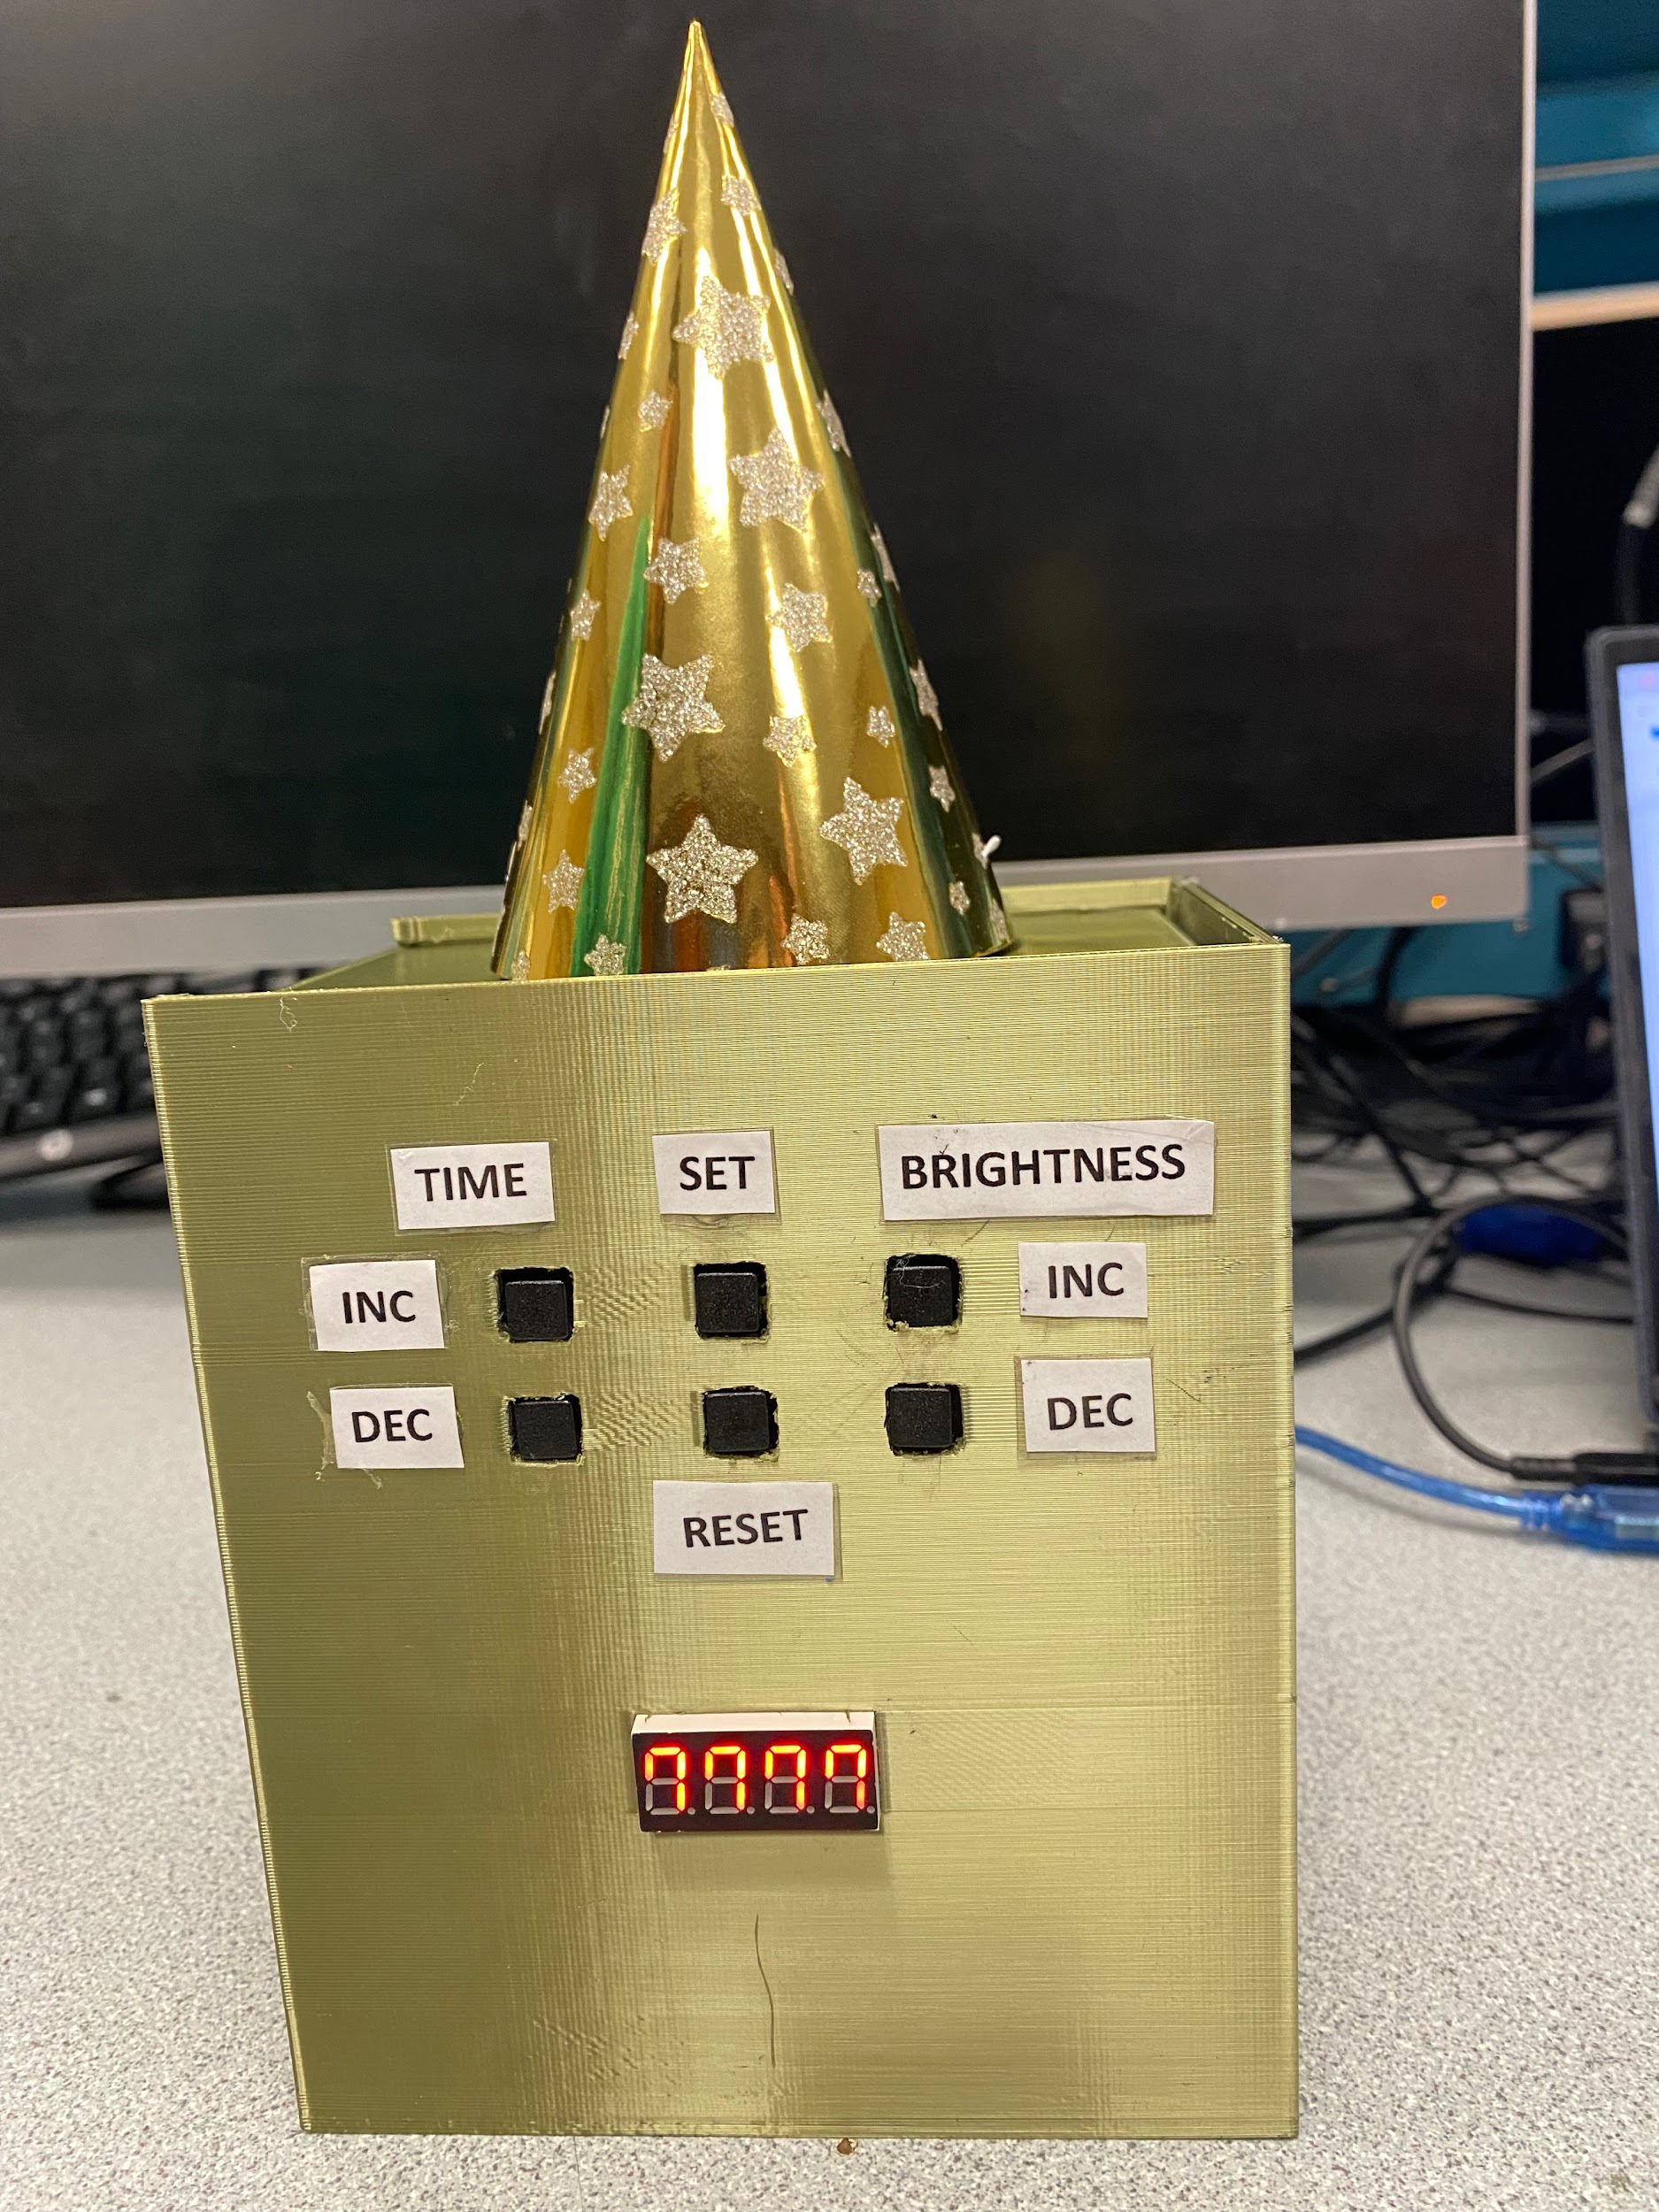
Party Time Timer
Joelle Czarissa Perez
Portia Bailey

Slide 2
Project Overview
The project asks for the team to create a timer. The timer will have two user outputs in the form of a seven segment display and a speaker. The timer will also allow user inputs in the form of switches and/or potentiometers.

Slide 3
System Requirements
System should be accurate
<1 second off every minute
System should be safe
IP43, power switch, connectors
System should be itutive
Switches, labels
The alarm should have an easy tone to hear
440 hz alarm
System should have dimmable lights
3 brightness levels
Additional requirement : Warning alarm at 10 seconds
Alarm every second starting at 10s

Slide 4
Contributors
Joelle Czarissa Perez
Arduino/Code
Seven Segment Display
Speaker
PCB
Portia Bailey
Enclosure
PCB
Power Supply

Slide 5
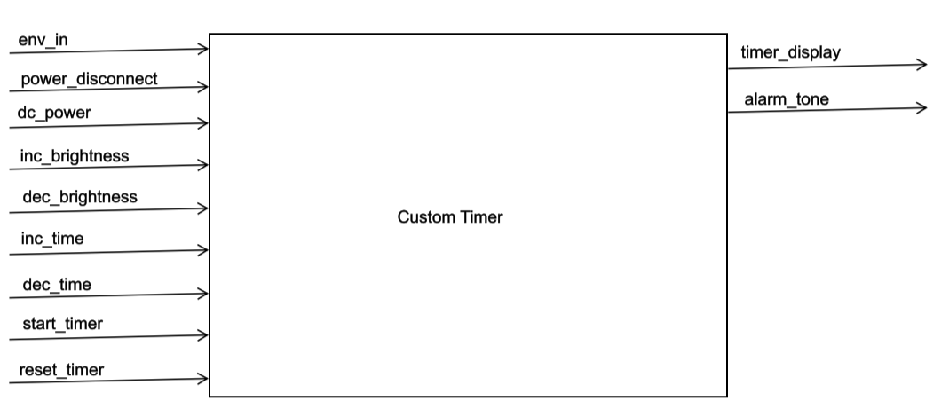
Black Box Diagram

Slide 6
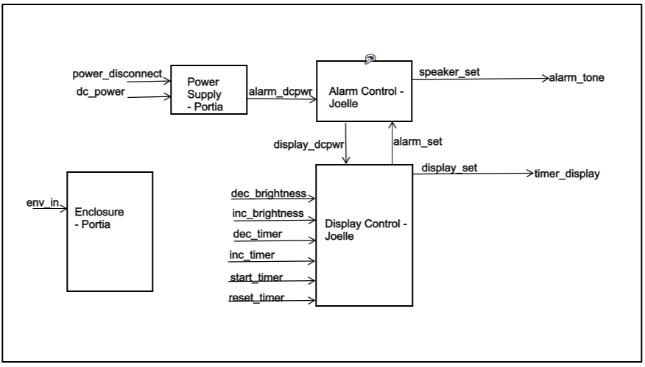
Top Level Design

Slide 7
Power Supply Block - Functionality
The purpose of this block is to implement a power disconnect switch to allow the user the ability to cut off the system from the power supply to fulfill the safety requirement. In addition, the power supply block is fitted with a custom-made PCB Buck Voltage Regulator that drops a 7V-12V input voltage to 5V to power the Arduinos.
Challenges:
The IC on the PCB was damaged. With no spares, the PCB was excluded from the final project

Slide 8
Power Supply Block - Wiring Diagram

Slide 9
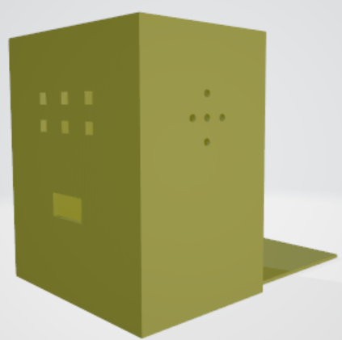
Enclosure Block - Functionality
This block contains the 3D printed design used to protect components from water and dust. The dimensions of the enclosure are (5.20 x 3.66 x 6.10)’’ ± .1’’.
Challenges:
First attempt was too small.
Complications with waterproofing.

Slide 10
Display Control Block - Functionality
This block controls any behavior that relates to updating the seven segment display. This includes all user inputs such as setting the time, starting and resetting the timer, and adjusting the brightness level of the display. This block fulfills the accuracy requirement and the light adjustable brightness requirement for this project.
Challenges:
During the integration phase, some of the push buttons were damaged when being desoldered from a protoboard.

Slide 11
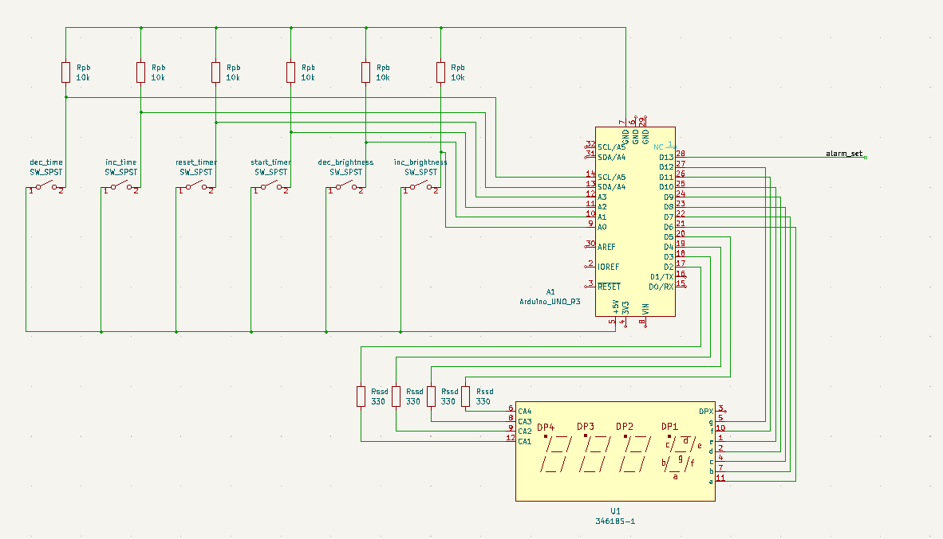
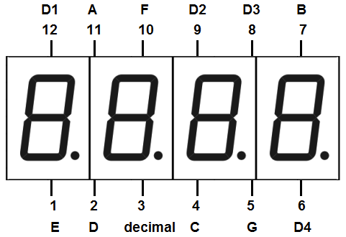
Display Control Block - Wiring Diagram and 7-Seg Display Pinout

Slide 12
Alarm Control Block - Functionality
This block controls all behaviors regarding the speaker. The Arduino in this block controls when the speaker outputs a tone, as well as ensures that the tone is at 440 hz which fulfills the tone requirement and the warning tone requirement. In addition, the block also has an amplifier circuit which ensures that the speaker outputs a loud enough tone to be audible.

Slide 13
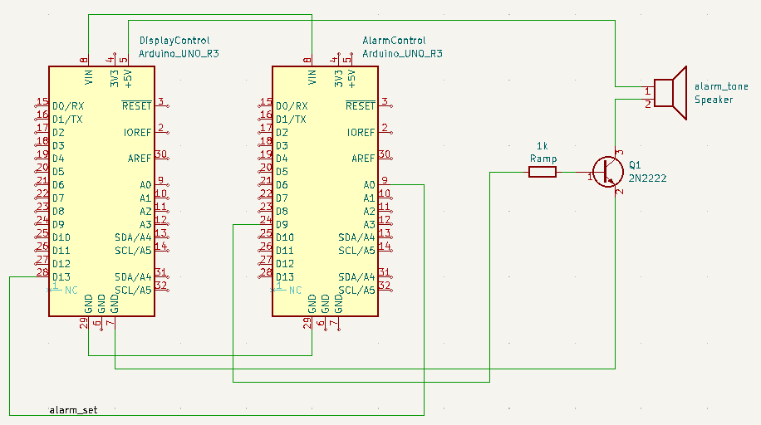
Alarm Control Block - Wiring Diagram

Slide 14
Achievements
Learned how to go through an iterative design process
Learned how to use 3D design software (TinkerCAD)
Learned how to design a PCB through KiCad

Slide 15
Future Developments/Uses
Desolder broken IC from PCB and solder on a working IC in order to add a PCB (buck voltage regulator) to the final product
Implement a sound chip in the system so custom alarm tones/sounds can be added
Add additional user inputs (switches) and edit Display Control block’s Arduino code to add stopwatch functionality

