Slide 1
Neurons for Neutrons: Preliminary Results of Predicting SMR Computation Load with Machine Learning
Alexander Mote, Lizhong Chen
The Center for Exascale Monte Carlo Neutron Transport (CEMeNT)
Oregon State University
October 6, 2022

Slide 2
Summary
Domain decomposition is needed for Exascale computing, but current methods use “trial and error”
Changes to subdomain allocation/input domain require new simulations
Machine Learning allows us to predict computation load, but necessitates a new optimization tool
Represent domain data in a way that works for computer vision
Train a CV model architecture on domain parameters
Results:
Current machine learning model can predict SMR computation load on an arbitrary domain decomposition with 79% accuracy
Model considers neutron transmission between subdomains and communication overhead
CNN and MLP models have been developed; MLP network currently outperforms, but CNN has potential for further development

Slide 3
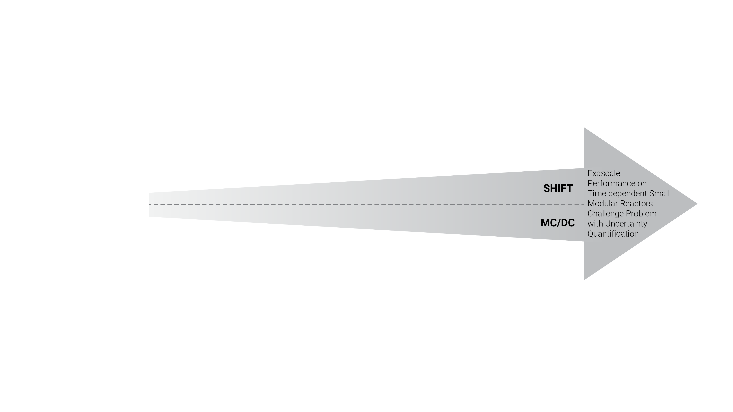
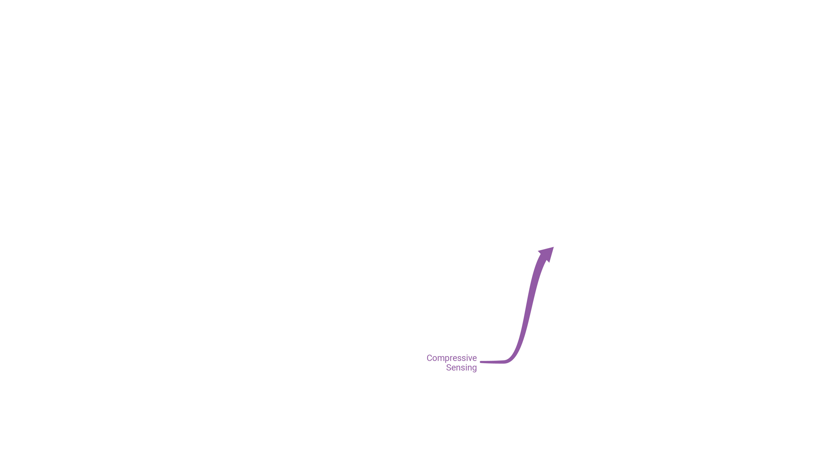
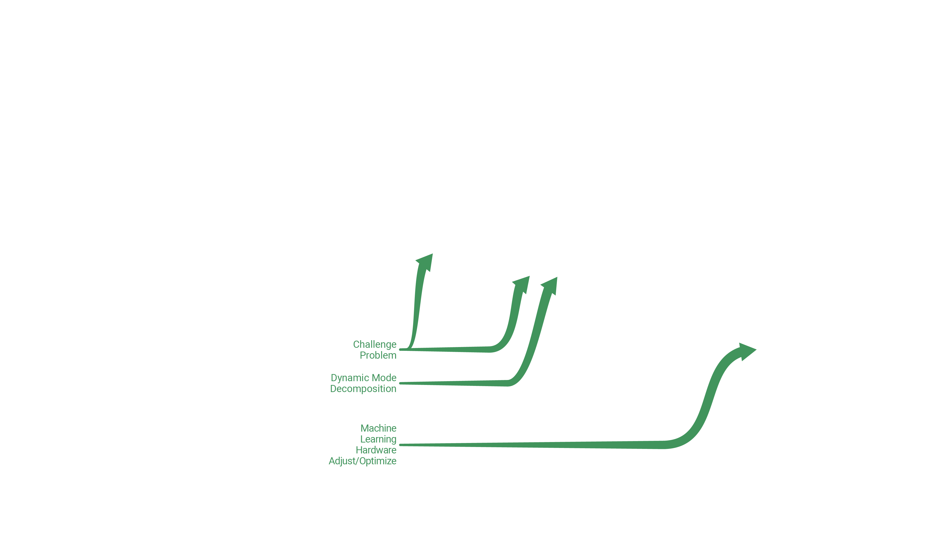
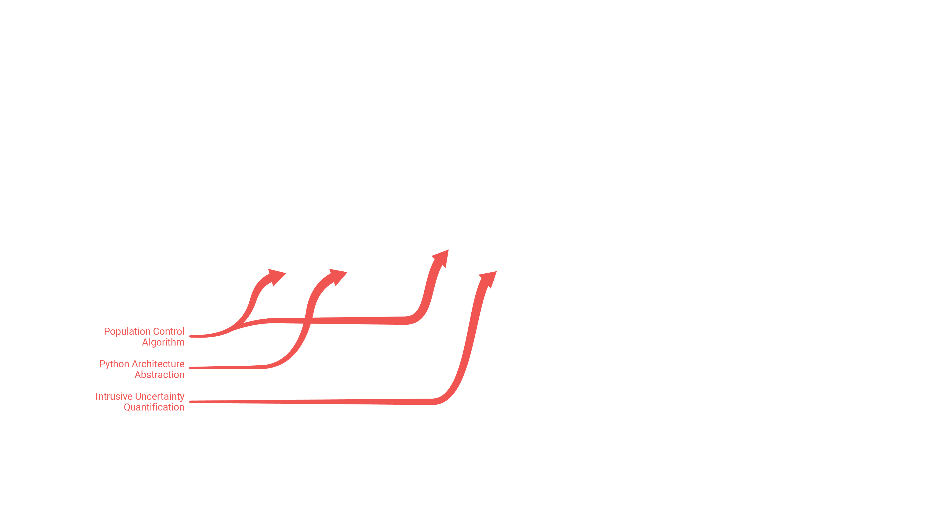
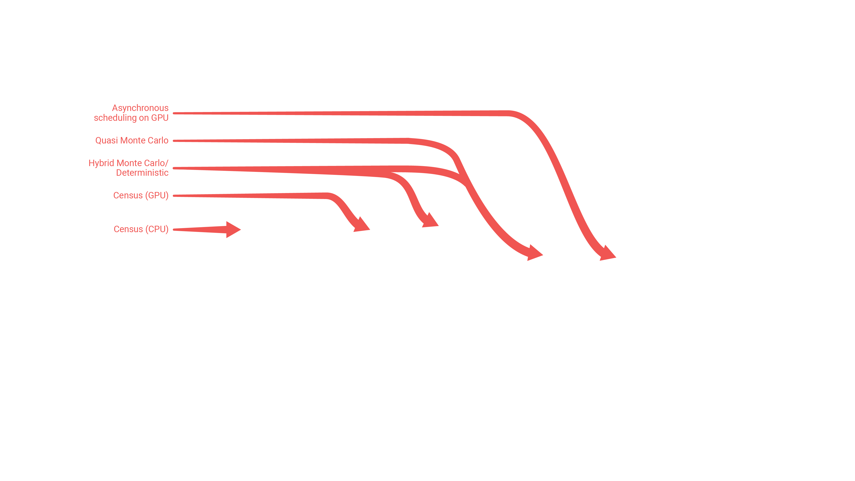
Research Objectives
Optimize heterogenous hardware utilization on HPC systems
Develop domain decomposition techniques to enhance parallel performance
Use Machine Learning to optimize parameter tuning for hardware allocation

Slide 4
Research Objectives
Optimize heterogenous hardware utilization on HPC systems
Develop domain decomposition techniques to enhance parallel performance
Use Machine Learning to optimize parameter tuning for hardware allocation

Slide 5
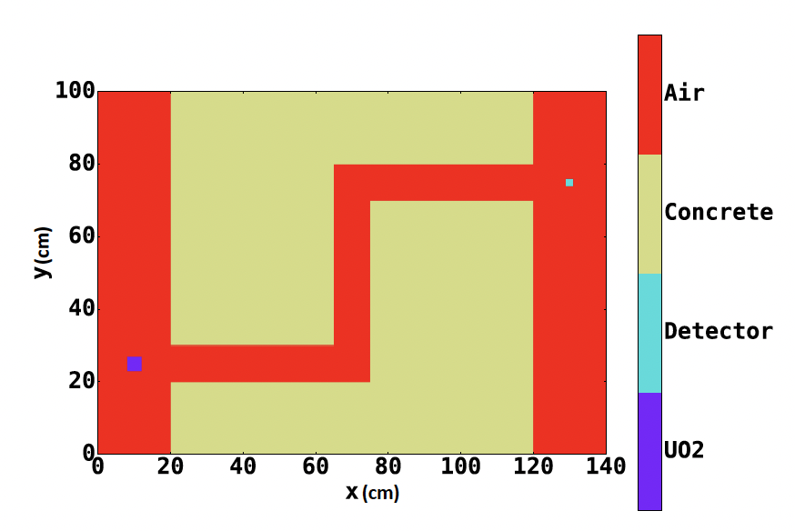
Current Domain Decomposition Method
Subdomain Initialization
Domain is divided into subdomains when input file is created
Small-Scale Simulation
Analyze runtime of divided domain with 1 processor per subdomain
Processor Allocation
Processors are assigned non-uniformly to balance workload
Image Source: Ellis et al., 2019

Slide 6
Why Machine Learning?
Subdomain & resource allocation parameters are tuned manually
Processors per task, subdomain creation, memory allocation, etc.
Small-scale simulations can take on the order of hours to run
Must be repeated whenever any configuration settings change
Machine Learning for Domain Decomposition is promising
Small-scale particle output can be approximated by a series of functions
Our unique problem requires a unique optimization tool

Slide 7
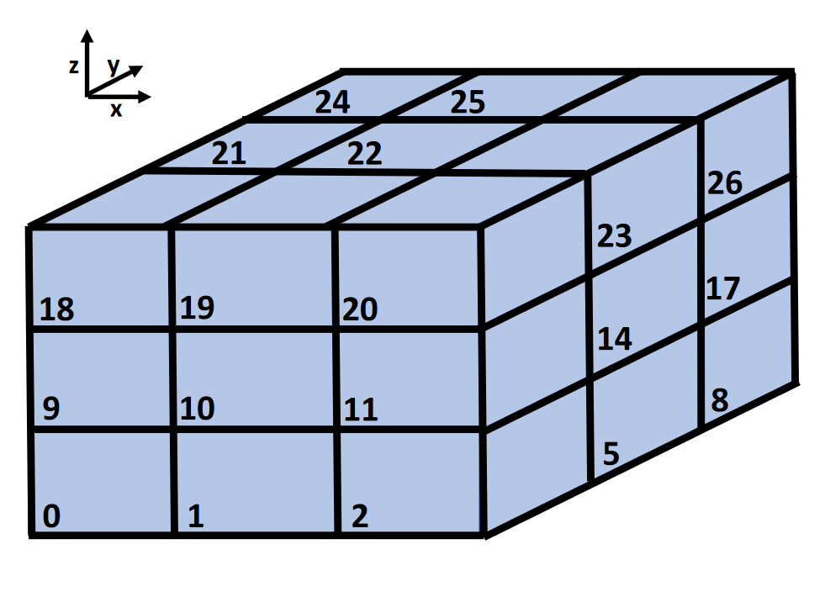
Creating a Model for Computation Load Prediction
Divide domain into N elementary spatial units
Create a vector v of computation-relevant data for each unit
Element composition, domain boundaries, etc.
Divide the domain into S subdomains according to user input
Assign each spatial unit to its subdomain
Add global parameters P from user input
Number of particles, cycles, etc.
From these inputs, predict a computation load L for each subdomain
Example 3D Domain Decomposition
Image Source: Ellis et al., 2019

Slide 8
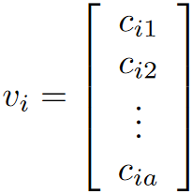
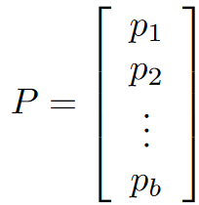
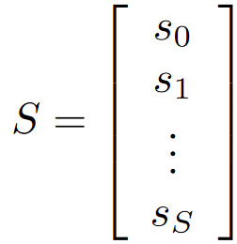
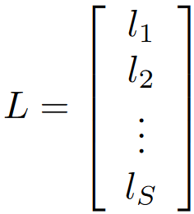
Creating a Model for Computation Load Prediction
+
→

Slide 9
Challenge/Solution 1: Fixed Input & Output Size
Shift simulations only provide particle data/computation information per subdomain
Variable sized input/output; not good for computer vision algorithms
Without a fixed input/output, separate models would have to be trained on each subdomain division
Additionally, internal spatial data within subdomain is lost with Shift storage
Fixed Input: NxN matrix
Preserves relationship between elementary domain units as well as subdomains
Each row contains all units within a given subdomain
Each column contains a single elementary domain unit vector
Fixed Output: N-element array
Each element represents combined computational load of each subdomain
Includes neutrons travelling between subdomains, and communication overhead

Slide 10
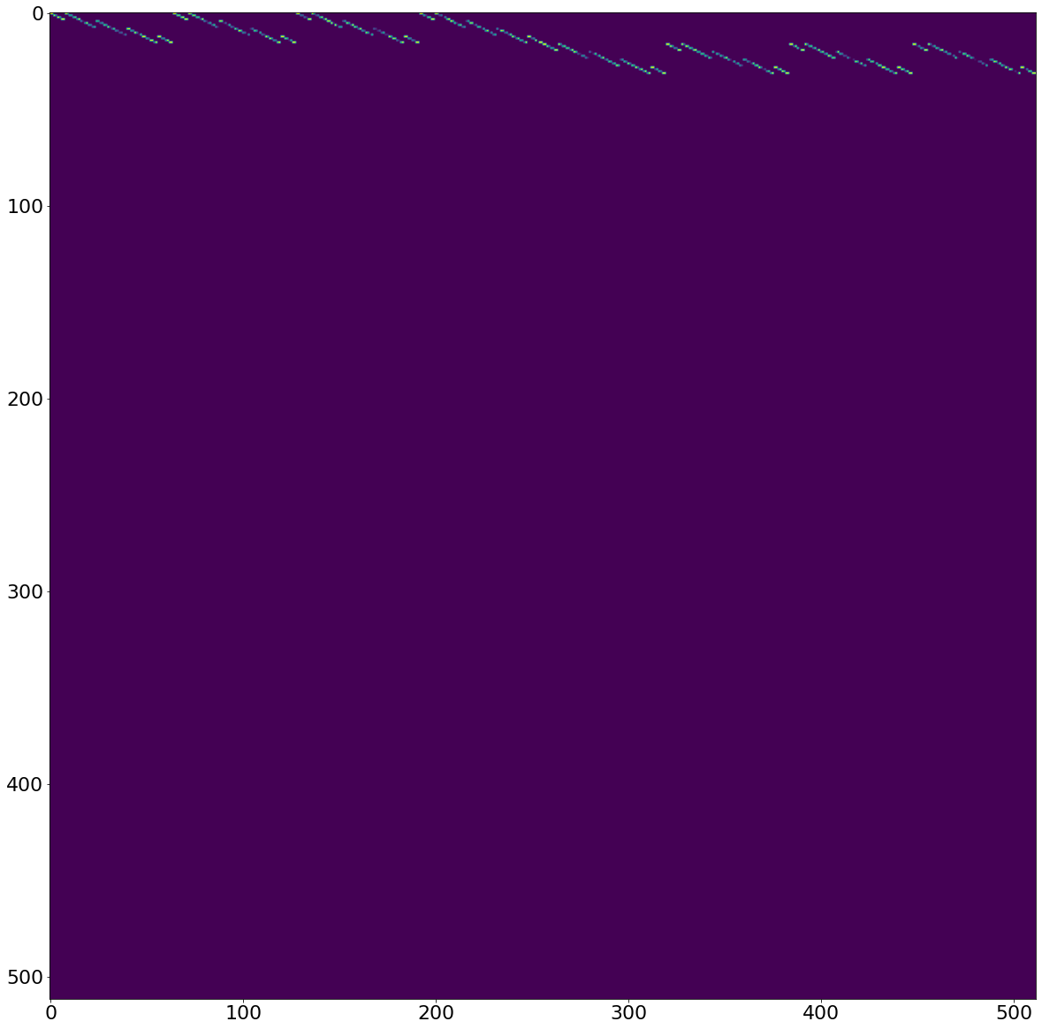
Current Model Input View
Example: 32 subdomains (4x4x2 decomposition)

Slide 11
Current Model Input View
Example: 32 subdomains (4x4x2 decomposition)

Slide 12
Current Model Input View
Example: 32 subdomains (4x4x2 decomposition)
Input assigns 512 elementary spatial units to 32 rows based on each unit’s subdomain
16 units per subdomain
Heatmap in this example indicates normalized number of particles held by each unit before simulation
Particle numbers were estimated from small-scale SMR simulations with 512 subdomains

Slide 13
Challenge/Solution 2: Generating Dataset
Generating input/output dataset for SMR subdomains is challenging
Thousands of datapoints are required to train the model
Each decomposition datapoint produces ~2GB of data → 4 TB of total data
Each datapoint requires ~40 minutes to simulate on Sierra → 1,300 hours of total simulation time
New data may need to be generated as model evolves and improves
Solution: Synthetic Dataset
Generated synthetic datapoints based on a small set of SMR simulations
Allowed for faster dataset generation, easier model design iteration, and saved computing resources
Data points can be generated that stress the model by simulating extreme/uncommon circumstances
Currently simulates net transfer between subdomains and communication overhead

Slide 14
Current Model Performance
Prediction accuracy decreases as number of subdomains increases
Most datapoints have a smaller number of subdomains
Model weights may need additional training at higher subdomain values
Overall Testing Set Accuracy: 79%
1000 datapoints in testing set
Improving Accuracy
Deeper network architecture
Tuning custom loss functions
Adding more features to dataset

Slide 15
Next Steps
Continue Development of the Machine Learning Model
Implement additional input vector features and global parameters
Generalize inputs from SMR to other reactor domains
Investigate optimization opportunities in time-dependent simulation
Use load prediction to generate optimal domain decompositions
Further Optimization Opportunities
Lassen Scheduler Parameters
GPU Memory Allocation/Access
Neutron Transport Task Scheduling (CUDA)
And More…

Slide 16
Conclusion
Subdomain computation load can be predicted by Machine Learning
Preliminary efforts have resulted in a model with a 79% prediction accuracy on SMR domains
MLP model currently performs best; however, CNN has more potential as additional input complexity is added

Slide 17
Questions

